Slide 1
Analysing Vulnerabilities in Smart Contracts
-By Shrutirupa Banerjiee

Slide 2
$whoami
WAF Research @Qualys
InfosecGirls Pune Chapter Lead
WomenWhoCode Pune Lead
Blockchain and Security Enthusiast
Independent Researcher
https://about.me/shrutirupa/

Slide 3
$cat Agenda
Some blockchain basics
Understanding Smart Contracts
Security Issues in Smart Contracts

Slide 4


Slide 5
$man cryptocurrencies
Virtual currency
Works as a medium of exchange
Uses strong cryptography for transactions

Slide 6

What do cryptocurrencies have in common???

Slide 7

blockchain

Slide 8
$nano blockchain
Chain of blocks
Linked with the help of hashes
Hash of each block is linked to it’s previous block

Slide 9
$man blockchain | grep “keypoints”
Decentralised
Immutable
Transparent
Anonymous
And many more…

Slide 10

Where does smart contract come in between?

Slide 11
The WHY factor!!
It creates some kind of logic and conditions
Dapps (Decentralised Applications)

Slide 12
$man SmartContracts
Piece of code
Partially Turing Complete
Provides logic to solve problems

Slide 13
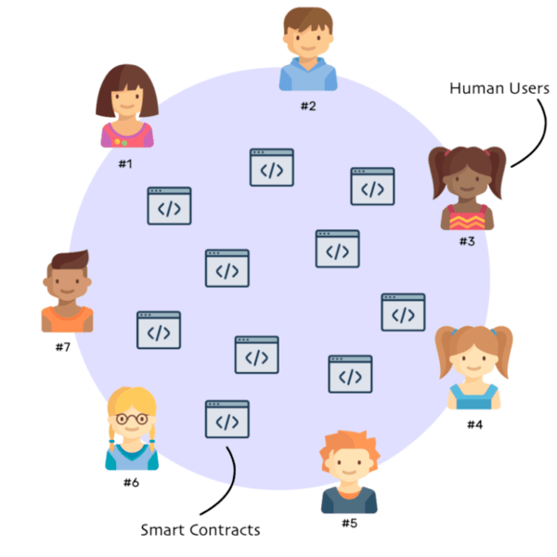

Slide 14
$man Solidity
Solidity is a contract-oriented programming language for writing smart contracts that run on the EVM.
It is used for implementing smart contracts on various blockchain platforms.

Slide 15
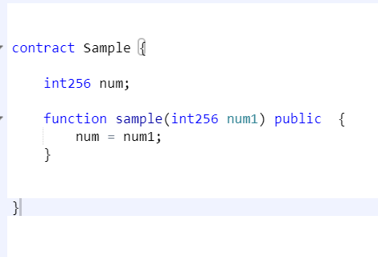

Slide 16
$man accounts
Public-private address/key pairs
Helps you to send/receive ethers
There are two types of accounts:
Externally owned – controlled by private keys
Contract – controlled by code

Slide 17
What is an EVM???
Turing complete (partially)
Read and executes bytecodes
Note: contract code is compiled into bytecode

Slide 18
$man gas
Execution fee
Fuel to keep on running the cryptocurrency

Slide 19
Why are we analyzing Smart Contracts???

Slide 20
Miners can take advantage of how they order operations in the Smart Contracts to benefit themselves, provided Miners are also the owners or users of the Smart Contracts
Methods publicly defined in a Smart Contract can be called by anyone
A vulnerable Smart Contract once deployed, can not be undone

Slide 21
Lets Analyse the issue!!!

Slide 22
Access Specifiers
Public
Private
Internal
External

Slide 23
Exception Handling
Execution logic runs out of gas
The logic invokes throw
Inconsistent methods that throw exceptions

Slide 24
Invalid Random Entropy Sources
Block.number
Block.gaslimit
Block.blockhash(block.number)
Block.timestamp
and many more
Note: Miners can take advantage of this entropy because the above values can be manipulated

Slide 25
Sending Money through Smart Contracts
Address.call.value()
Address.send()
Address.transfer()
Note: All the above methods trigger fallback function in the contract

Slide 26
Invoking Contracts Directly
Call()
delegateCall()
Directly -> ExternalContract.methodToInvoke()

Slide 27
Fallback Functions
Called when no method matches from an external request
Called when users send money through send(), transfer(), call.value() method
Need payable modifier to receive money

Slide 28
Here are some more!
Tx.origin
Dynamic Libraries
Transaction Order Dependence
Timestamp Dependency

Slide 29
Some Famous Attacks
Reentrancy
Wrong Constructor Name
Denial Of Service
Integer Underflow/Overflow

Slide 30
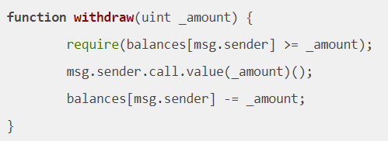
Reentrancy

Slide 31
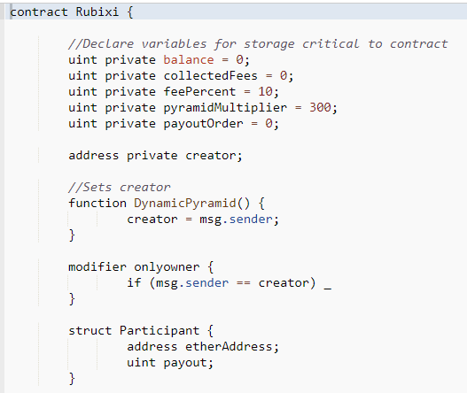
Wrong Constructor Name

Slide 32
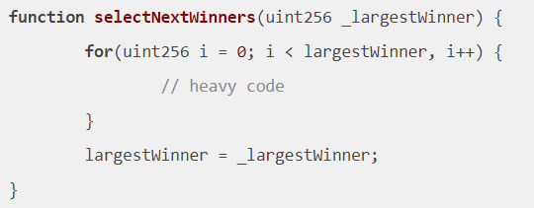
Denial Of Service

Slide 33
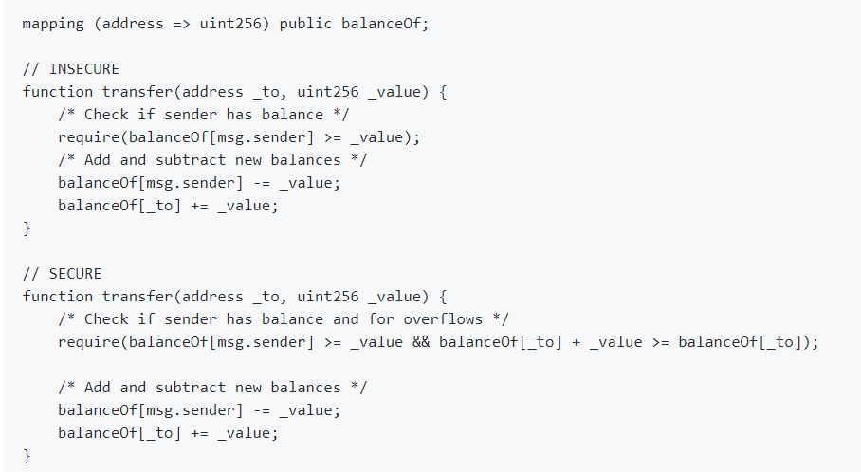
Integer Underflow/Overflow

Slide 34

$find / -name questions.ask 2 > /dev/freak_crypt

Slide 35
References
https://brage.bibsys.no/xmlui/bitstream/handle/11250/2479191/18400_FULLTEXT.pdf?sequence=1
https://www.youtube.com/watch?reload=9&v=apCGPh7tKhw
https://eprint.iacr.org/2016/1007.pdf

Slide 36
Thank you

